Slide 1
Auto Exposure
&
Tone Mapping
Presenter: Chia-Hung Chou周家弘
E-mail: zhou860925@gmail.com
Phone: 0978909095
Advising Professor: Chiou-Shann Fuh 傅楸善 教授

Slide 2
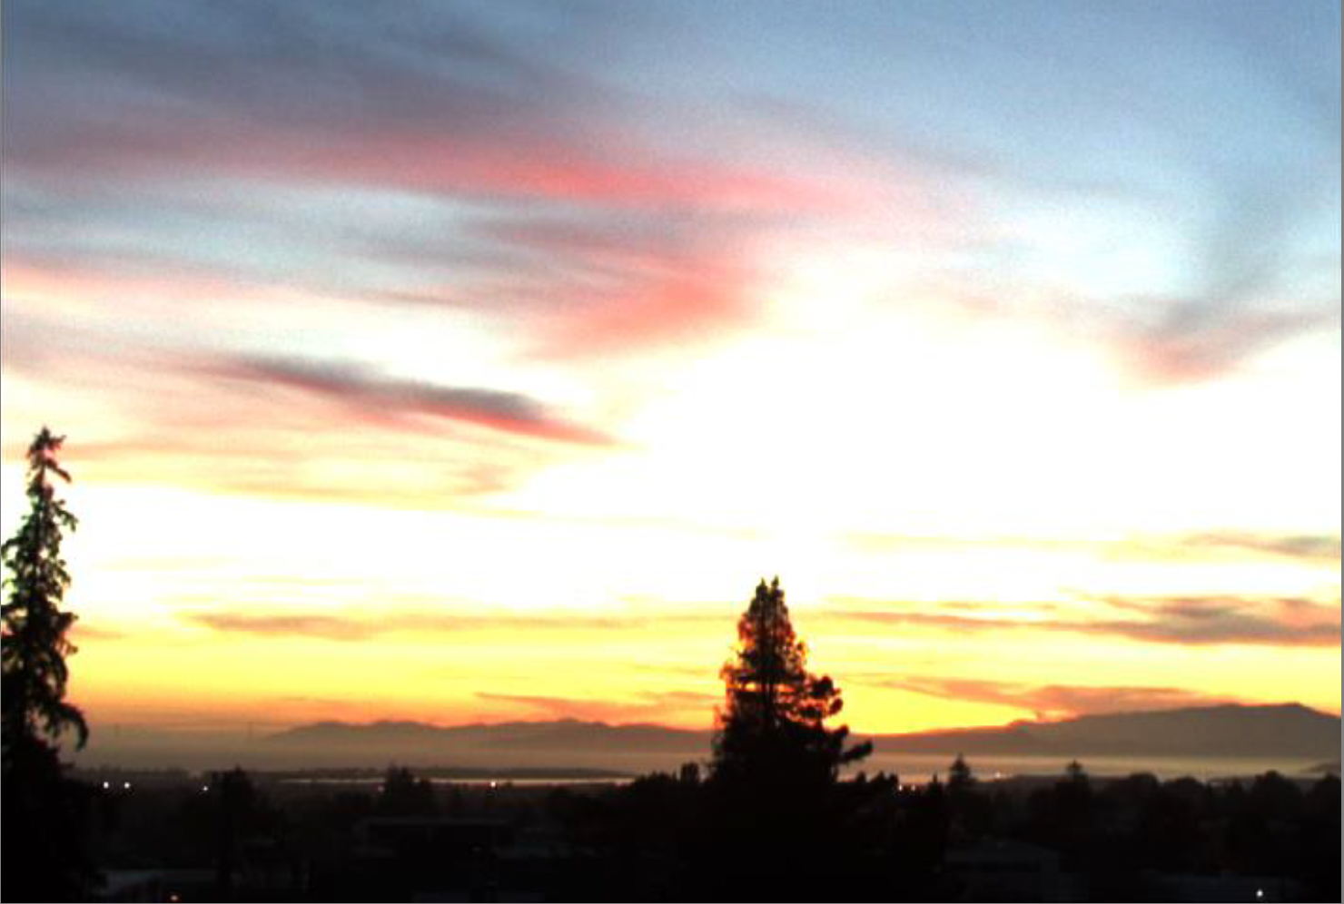
Introduction (1/7)
01
Request
Image Processing
莊永裕教授-數位視覺效果
01

Slide 3
Introduction (1/7)
01
Request
Image Processing
莊永裕教授-數位視覺效果
01

Slide 4
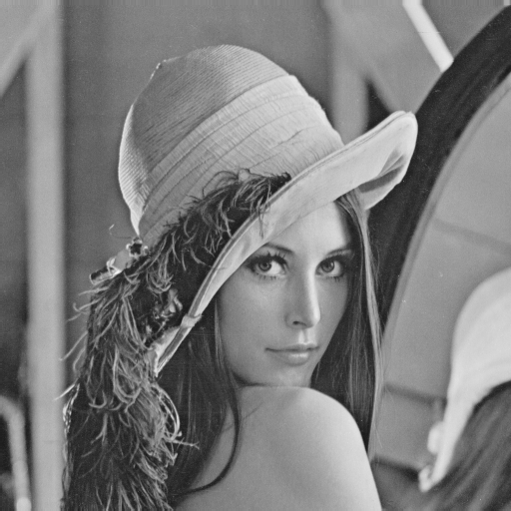
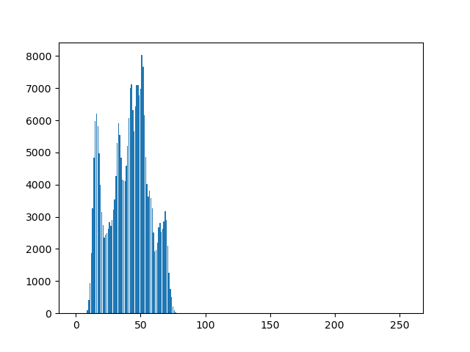
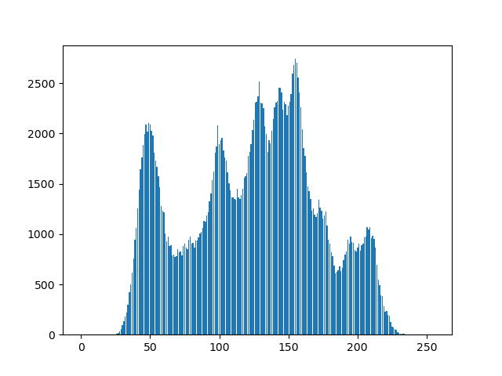
Introduction (1/7)
01
Auto Exposure
Algorithm
Estimate scene brightness using image histogram
Select initial values for parameters based on brightness
Fine-tune values to optimize image quality and desired exposure level
Account for constraints between parameters (e.g exposure triangle)
01

Slide 5
Introduction (2/7)
01
Tone Mapping
We are more sensitive to contrast
莊永裕教授-數位視覺效果
02

Slide 6
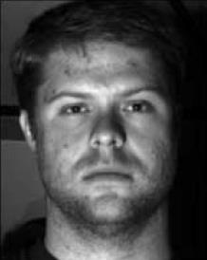
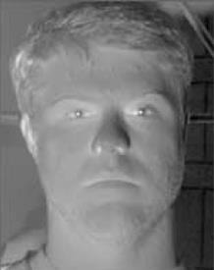
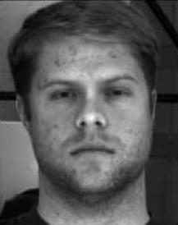
Introduction (2/7)
01
Tone Mapping
Frequency Domain
image = illuminance * reflectance
low-frequency
attenuate more
high-frequency
attenuate less
莊永裕教授-數位視覺效果
02

Slide 7
Introduction (2/7)
01
Tone Mapping
莊永裕教授-數位視覺效果
02

Slide 8
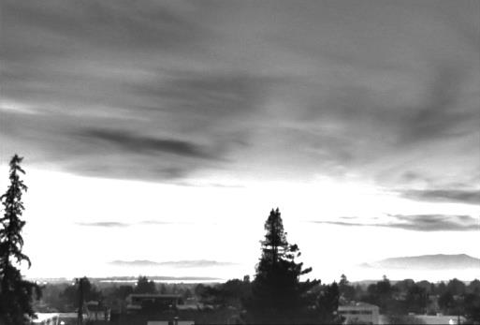
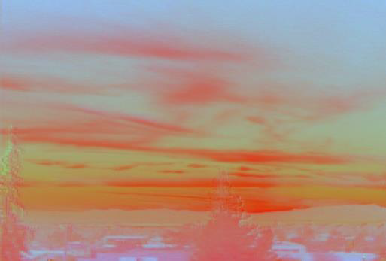
Introduction (2/7)
01
Tone Mapping
莊永裕教授-數位視覺效果
02

Slide 9
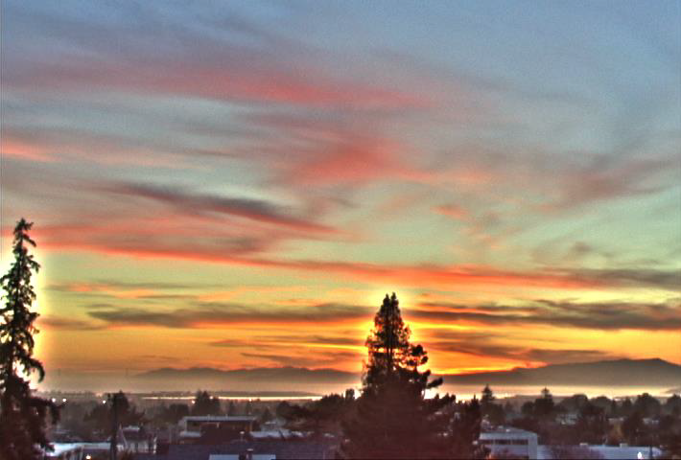
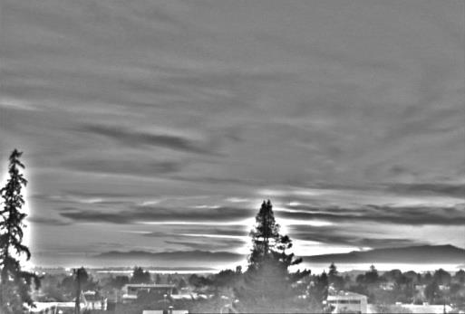
Introduction (2/7)
01
Tone Mapping
Low freq.
High freq.
莊永裕教授-數位視覺效果
02

Slide 10
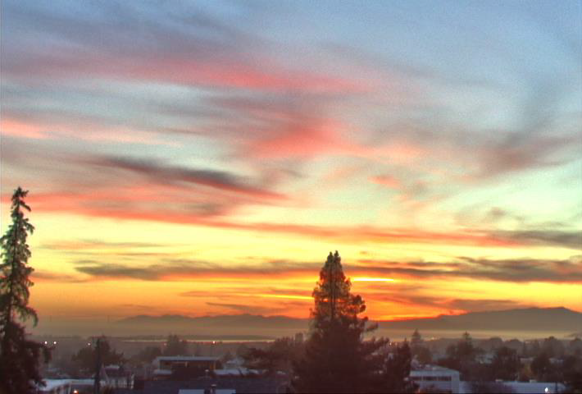
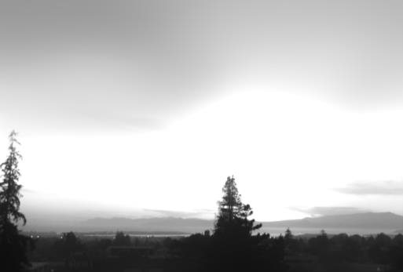
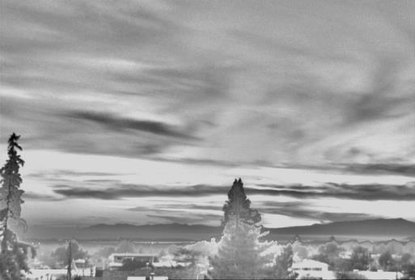
Introduction (2/7)
01
Tone Mapping
Large Scale
Low freq.
Detail
High freq.
莊永裕教授-數位視覺效果
02

Slide 11
Methodology (3/6)
02
HDRI(High Dynamic Range Image)
HDRI is an image format that can represent a wider range of luminance levels(wider bit length)
HDR image can be generate by multiple LDR images.
莊永裕教授-數位視覺效果
10
Notes:
在訓練步驟中，第一步涉及確定每個補丁屬於哪個類別的過濾器。 第二步是獲取該類別的所有補丁並將它們輸入方程以找到最合適的過濾器。

Slide 12
Methodology (1/6)
02
LDR: Low Dynamic Range HDR: High Dynamic Range
Input contains 3 YUV420 images with different EV.
EV -1
If noise exists
Auto Exposure
Tone
Mapping
EV 0
HDR image
Denoise
EV +1
08

Slide 13
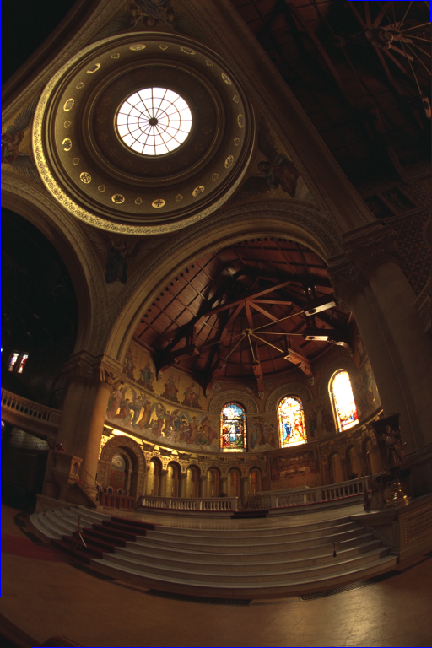
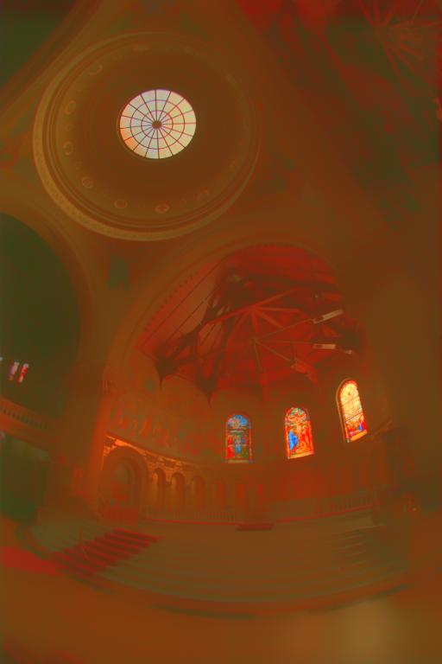
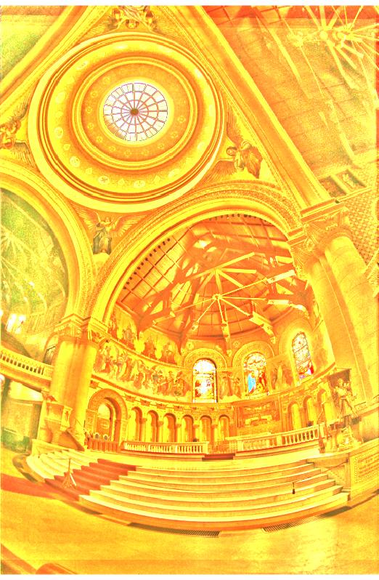
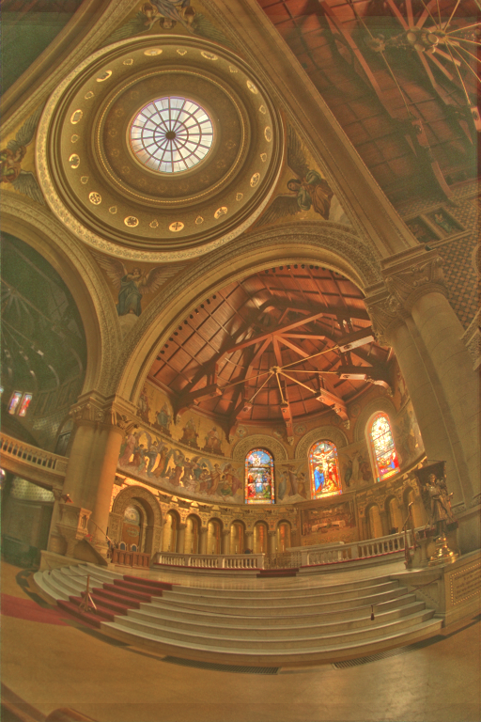
Methodology (2/6)
02
Durand’s Algorithm
Step 1
Step 2
Step 3
Original Image | Base Layer | Detail Layer | Tone Mapped Image
09

Slide 14
Methodology (4/6)
02
Denoise
https://vimeo.com/139199224
11
Notes:
GPU 與 CPU
GPU具有更簡單的控制單元、ALU單元和緩存設計。 否則，它們的數量會更大。 這使得 GPU 能夠熟練地處理大量簡單任務。
在速度方面，GPU 比 CPU 具有顯著優勢，通常快 10 到 100 倍。

Slide 15
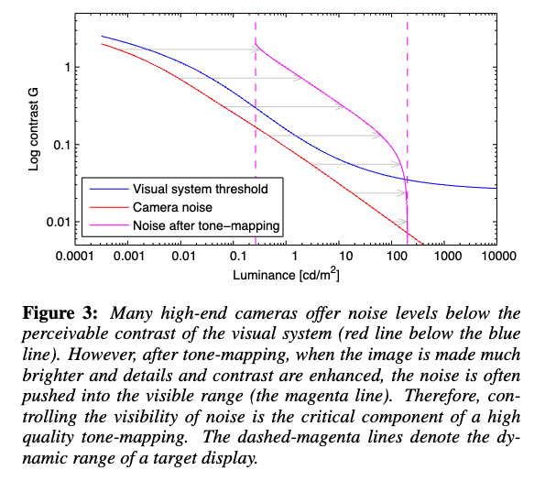
Methodology (4/6)
02
Denoise
Goal: Keep the noise below visibility threshold
Method: Combine multiple existing denoising methods, filter removes high amplitude noise and low amplitude noise is hidden.
https://vimeo.com/139199224
11
Notes:
GPU 與 CPU
GPU具有更簡單的控制單元、ALU單元和緩存設計。 否則，它們的數量會更大。 這使得 GPU 能夠熟練地處理大量簡單任務。
在速度方面，GPU 比 CPU 具有顯著優勢，通常快 10 到 100 倍。

Slide 16
Methodology (5/6)
02
GPU: Graphics Processing Unit
CPU: Central Processing Unit
ALU: Arithmetic Logic Unit
DRAM: Dynamic Random-Access Memory
Improve Execution Speed
GPU vs. CPU
Control Unit
ALU Unit
ALU Unit
Control
ALU
ALU
ALU
ALU
ALU
ALU
ALU
ALU Unit
ALU Unit
Cache
Control
ALU
ALU
ALU
ALU
ALU
ALU
ALU
Cache
Cache
Control
ALU
ALU
ALU
ALU
ALU
ALU
ALU
Cache
Control
ALU
ALU
ALU
ALU
ALU
ALU
ALU
Cache
DRAM
DRAM
CPU
GPU
https://www.gigabyte.com/tw/Article/cpu-vs-gpu-which-processor-is-right-for-you
12

Slide 17
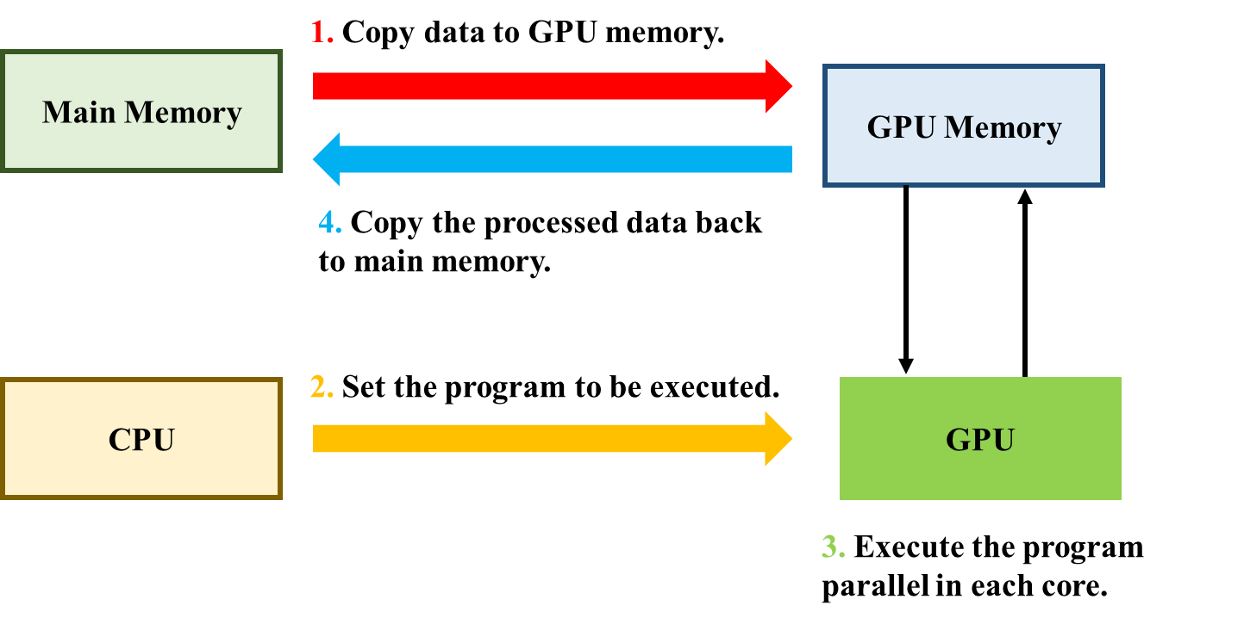
Methodology (6/6)
02
CUDA: Compute Unified Device Architecture
Improve Execution Speed
CUDA
CUDA is a parallel computing architecture proposed by Nvidia.
The compiler of CUDA program is NVCC (NVidia CUDA Compiler).
CUDA processing flowchart.
13
Notes:
CUDA
CUDA是Nvidia提出的並行計算架構。
CUDA程序的編譯器是NVCC（NVidia CUDA Compiler）。

Slide 18
03
Expected Results
14

Slide 19
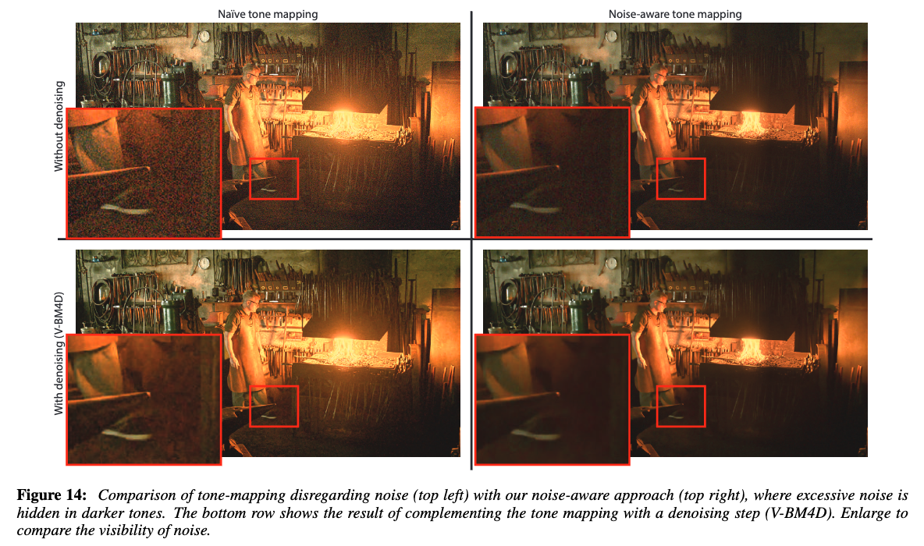
03
03
Expected Results
14

Slide 20
Test
04
Method: Use Tone Mapping with Frequency Domain Operator.
Steps: Generate HDR image => Auto Exposure => Tone Mapping (=> Denoise)
Results: Obtain an image with balanced illumination.
EV -1
If noise exists
Auto Exposure
Tone
Mapping
EV 0
HDR image
Denoise
EV +1
26

Slide 21
Thanks for listening !
Presenter: Chia-Hung Chou周家弘
E-mail: zhou860925@gmail.com
Phone: 0978909095
Advising Professor: Chiou-Shann Fuh 傅楸善 教授

Slide 22
References
05
https://www.csie.ntu.edu.tw/~cyy/courses/vfx/10spring/lectures/handouts/lec03_hdr.pdf
https://www.youtube.com/watch?v=wbn5ULLtkHs
https://zhangboyu.github.io/
https://developer.ridgerun.com/wiki/index.php/RidgeRun_Auto_exposure/Auto_white_balance_library_for_DM368_and_DM365

